Slide 1

LEAP 2025 Bootcamp Day 1
Instructor: Qingyuan Yang
(Associate Research Scientist)
Contact: qy2288@columbia.edu

Slide 2
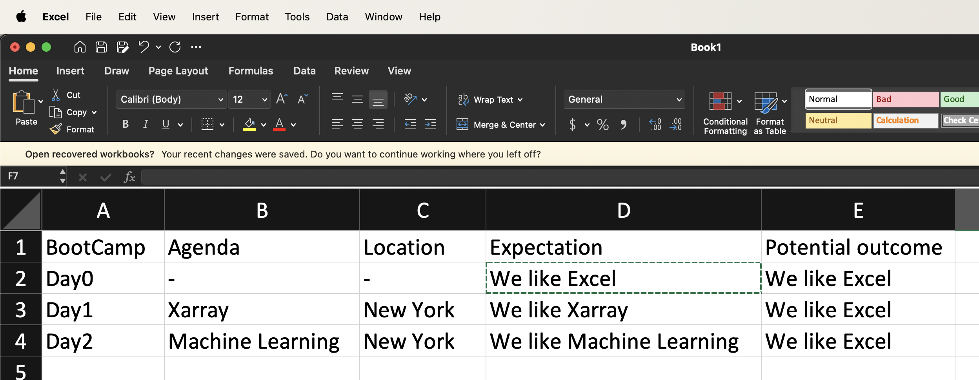

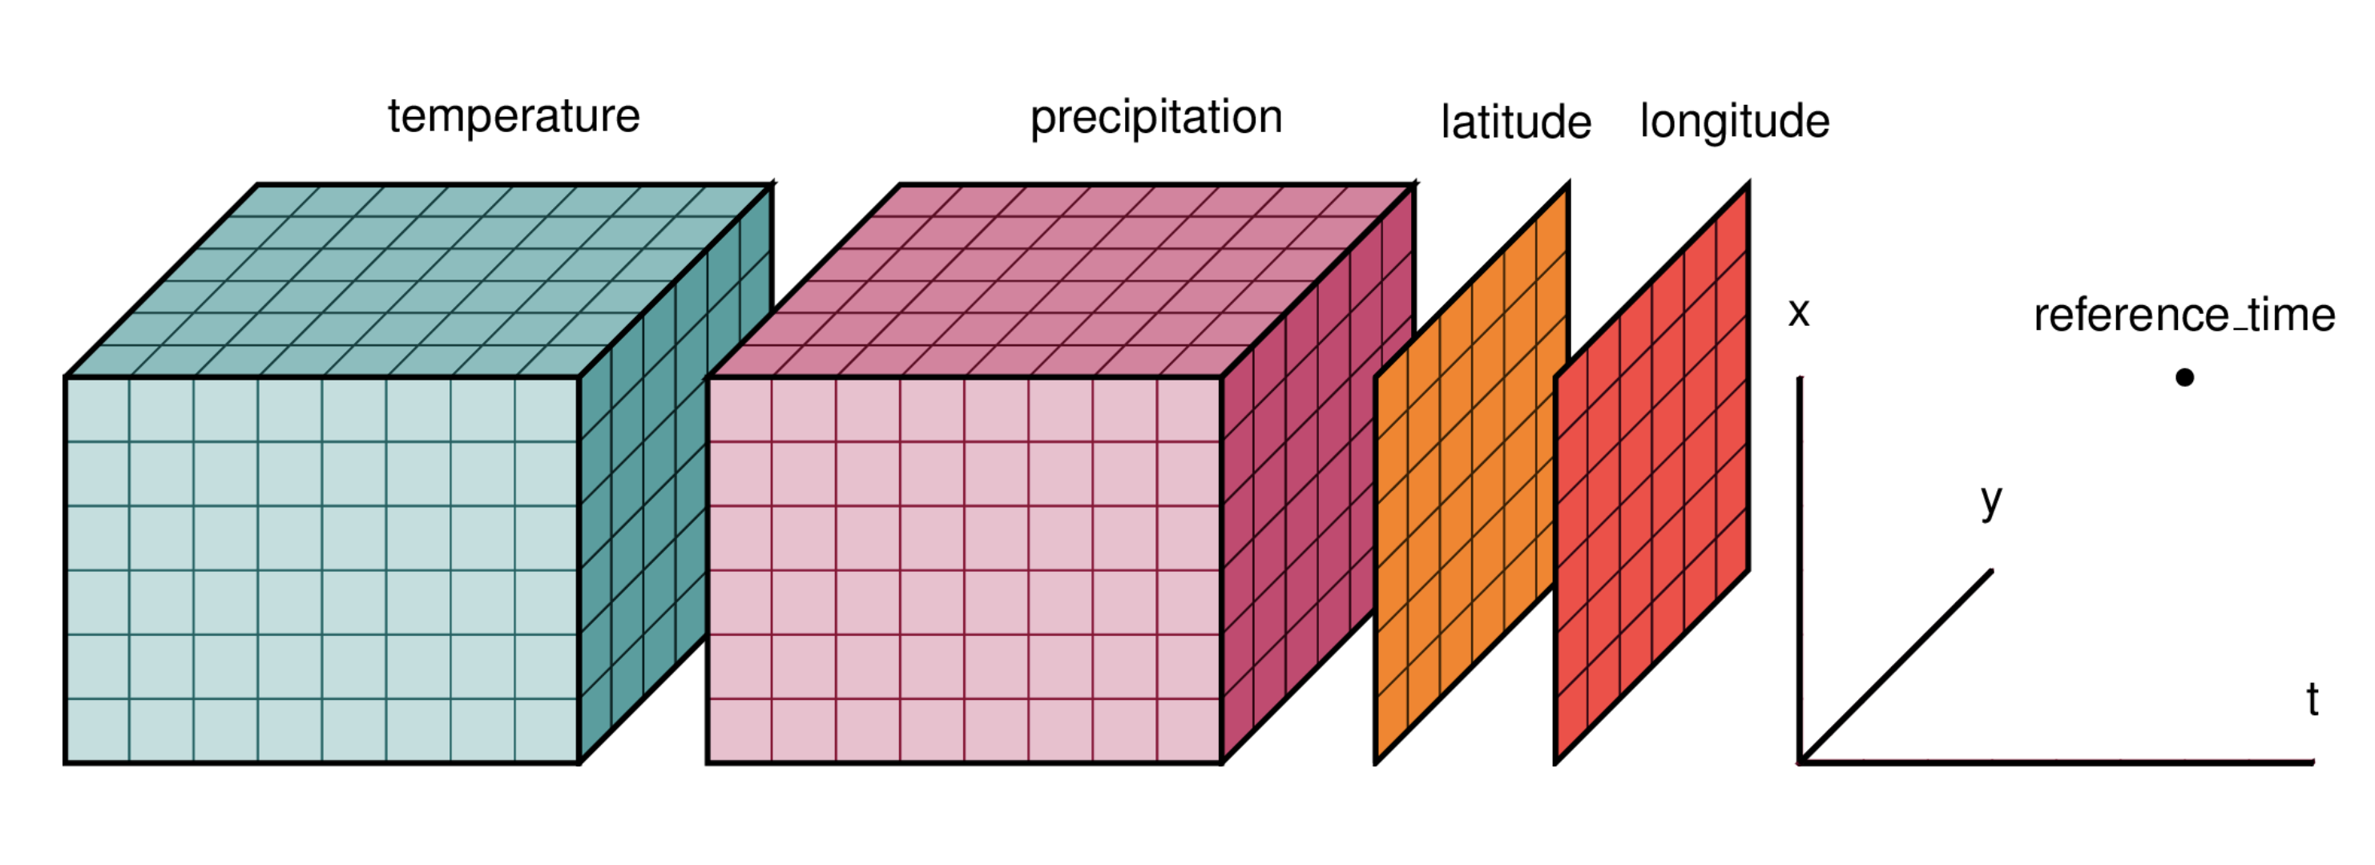

Agenda
Climate data & LEAP-Pangeo
Basic xarray
Advanced xarray
Climate Data in the cloud
Lecture materials and assignments reference: https://earth-env-data-science.github.io/intro.html (Ryan Abernathey, with significant contributions from Kerry Key, Tim Crone, and Julius Busecke)

Slide 3
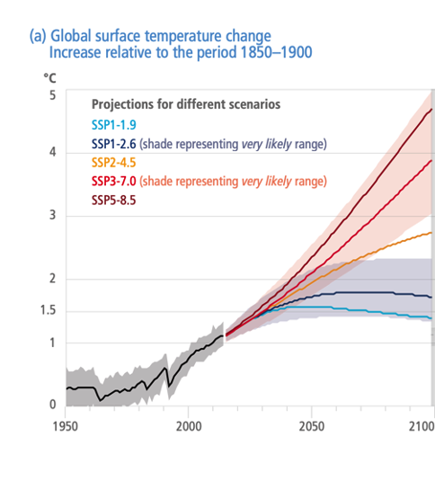
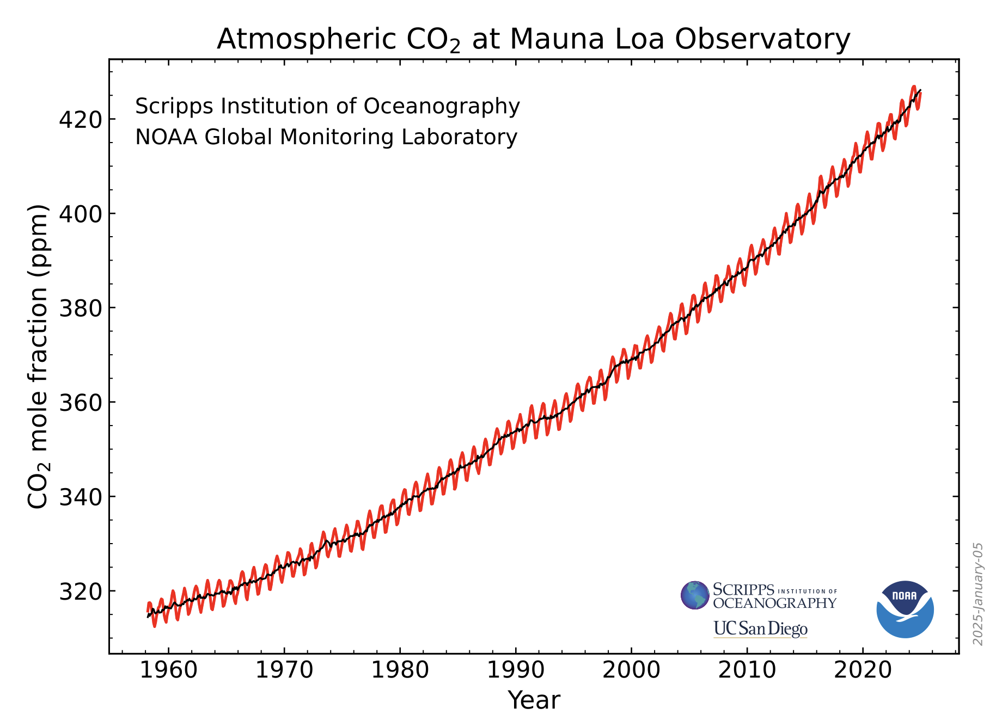
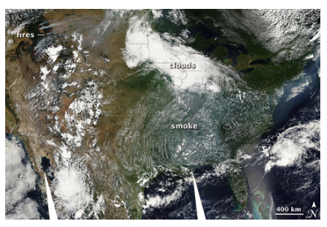
Climate data
Sources/kinds of climate data?
Smoke from western wildfires covered much of the United States on August 4, 2007. (NASA image by Holli Riebeek and MODIS Rapid Response).
p.18, IPCC Climate Change 2022 Impacts, Adaptation and Vulnerability Summary for Policymakers

Slide 4
Climate data
How they are organized?
Simplest form: tabulated data in excel
What about observational dataset and CMIP dataset (simulations)?
Vectors vs grided rasters
What is CMIP?

Slide 5
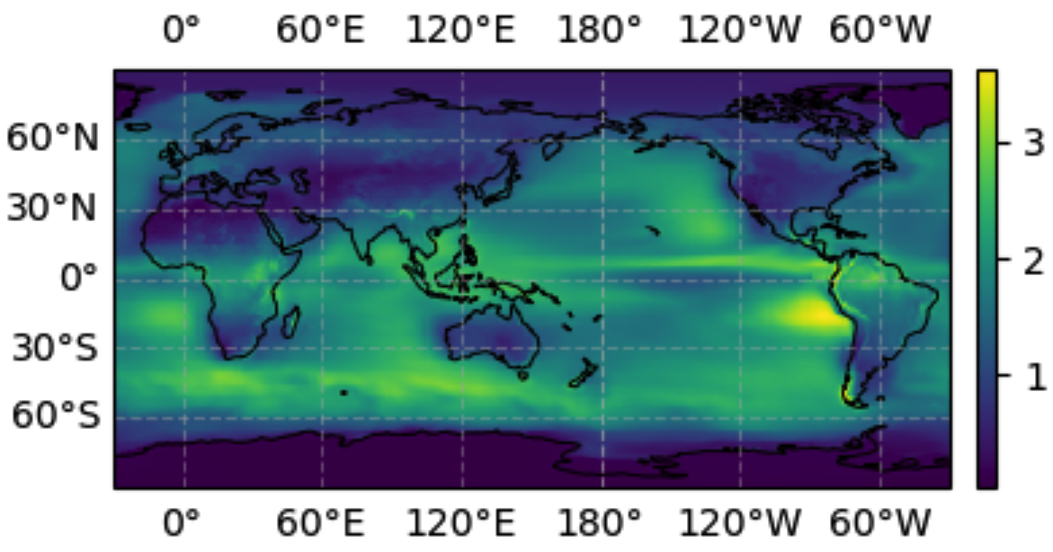
Going back to Climate data
How observational and simulation datasets are organized?
Pretty complicated: temperature, humidity, and many other variables at different times, locations, and etc.
A simple example
Hence, xarray (more on it later)!

Slide 6
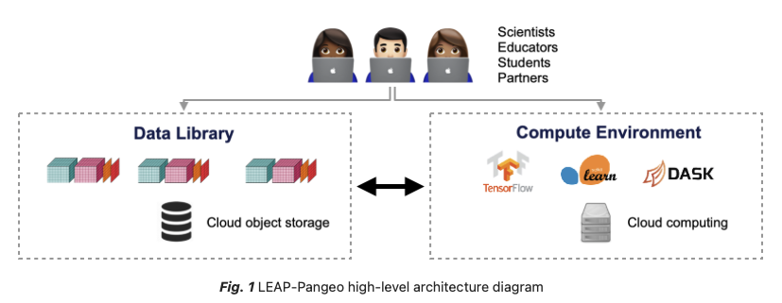
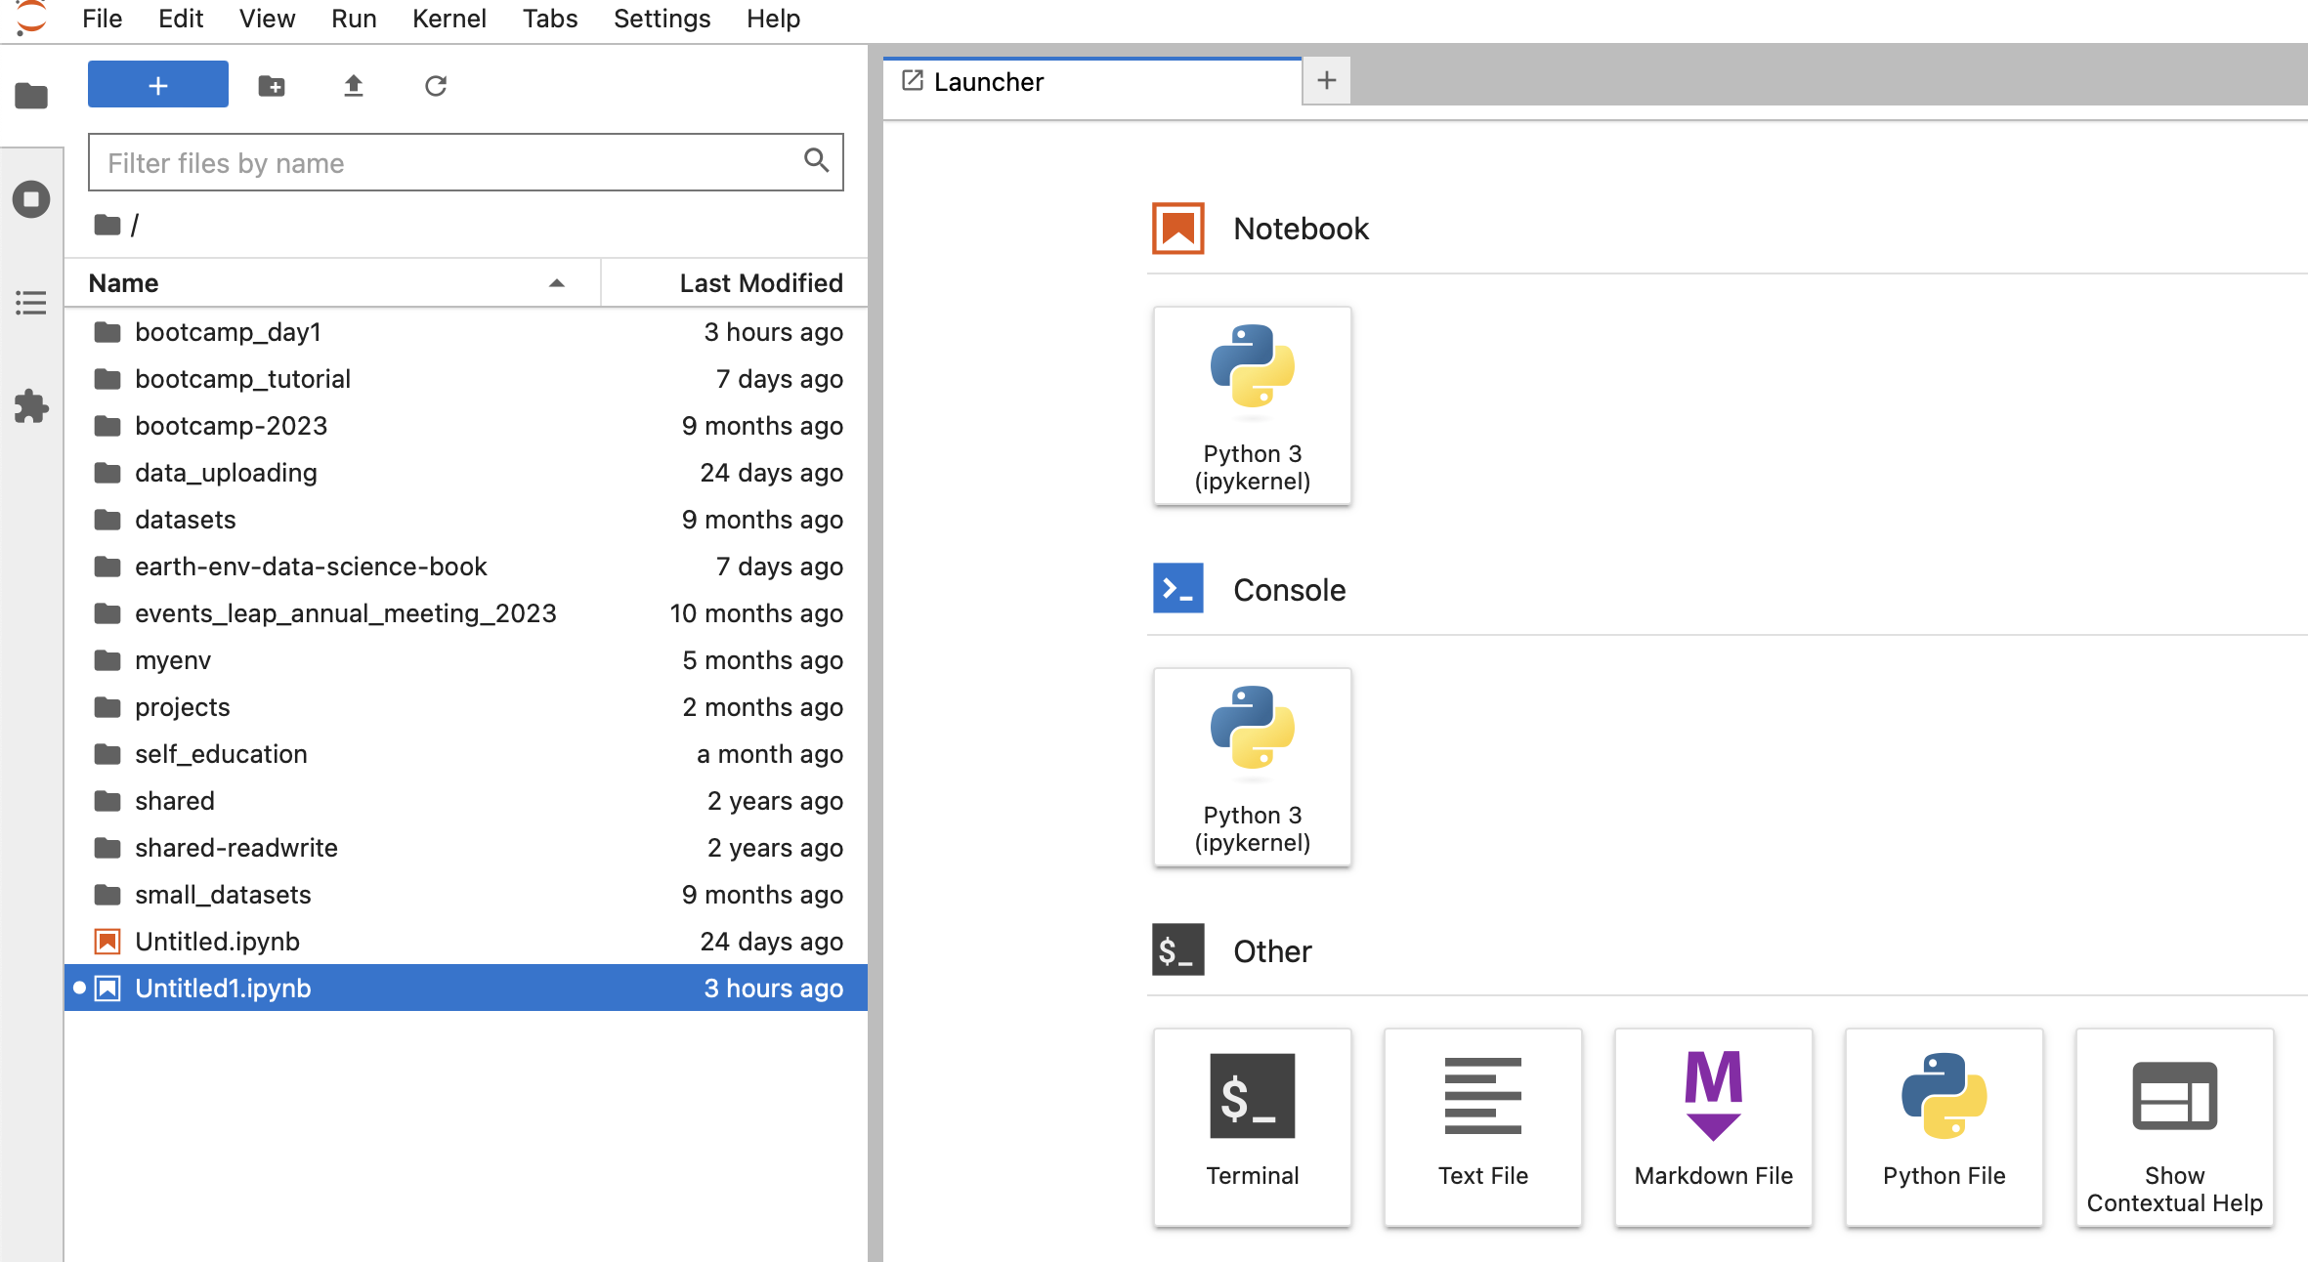
LEAP-Pangeo
https://leap-stc.github.io/explanation/architecture.html
See more on LEAP Pangeo: https://leap-stc.github.io/tutorials/getting_started.html

Slide 7
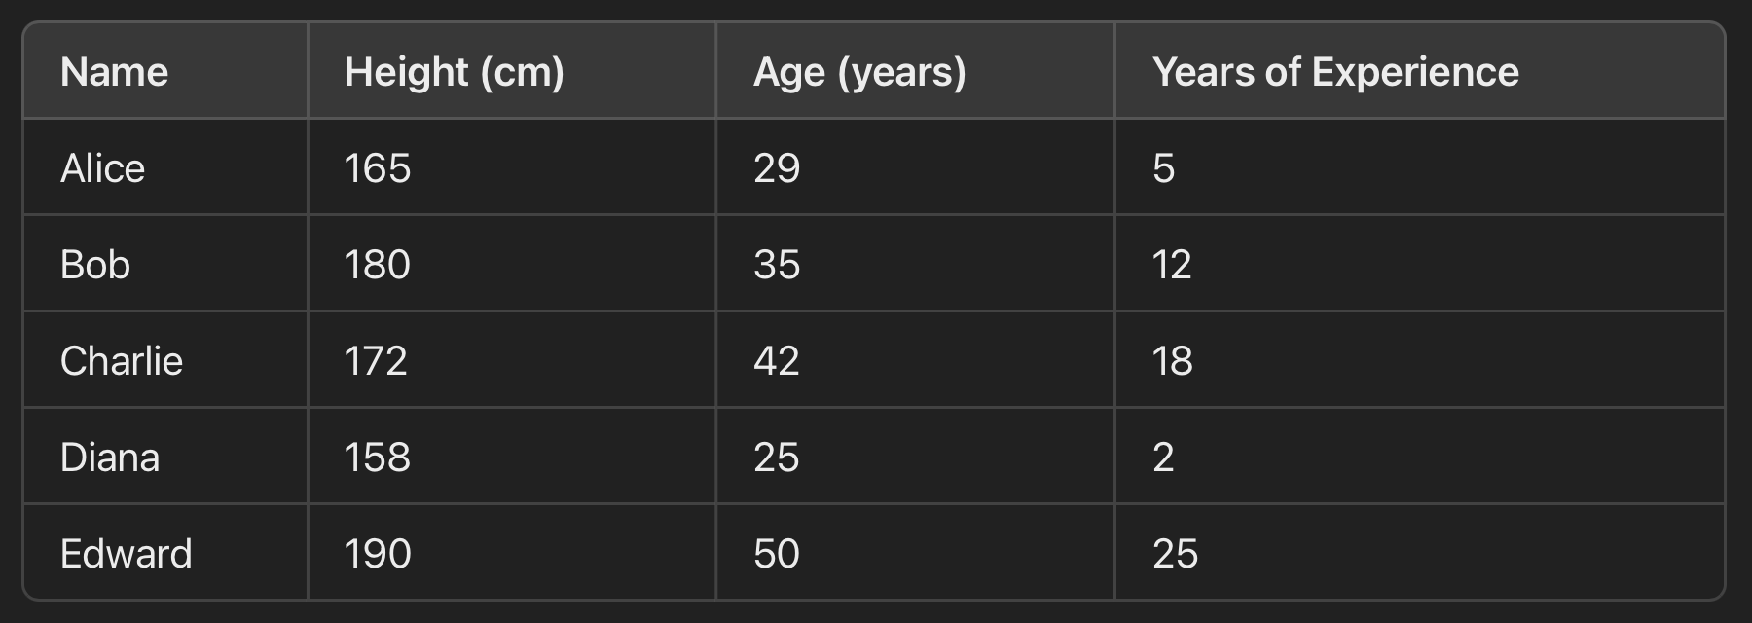
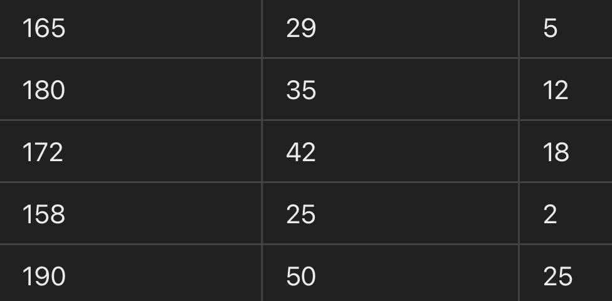
Before more on xarray
How much we are familiar with numpy and pandas?
It's derived from the econometrics term "panel data," which refers to datasets that include observations over multiple time periods for the same individuals.

Slide 8
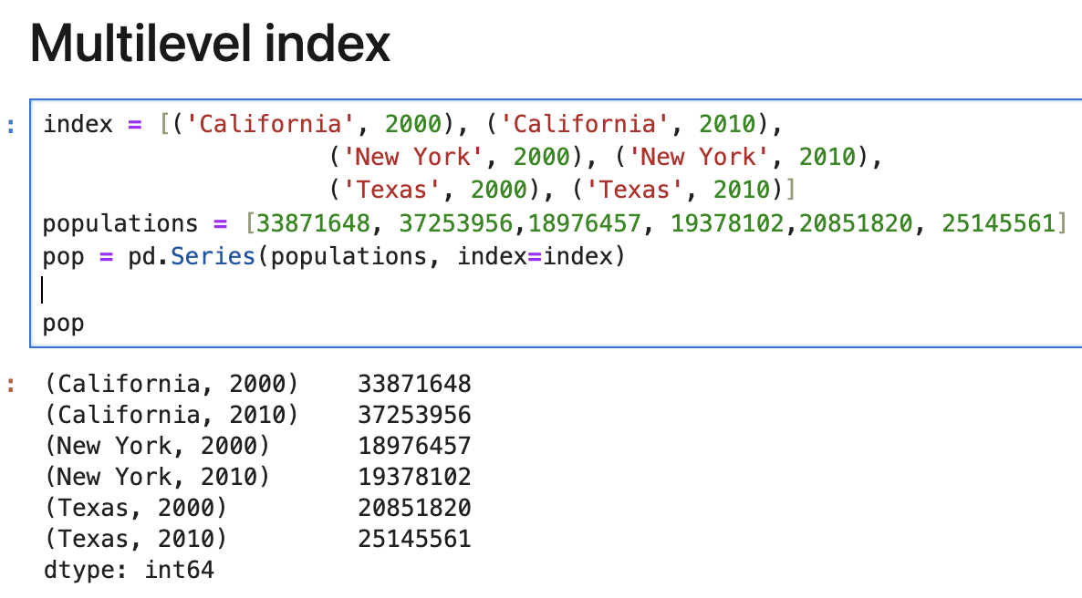
Let’s begin with pandas!

Slide 9
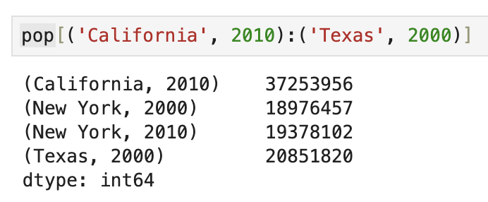
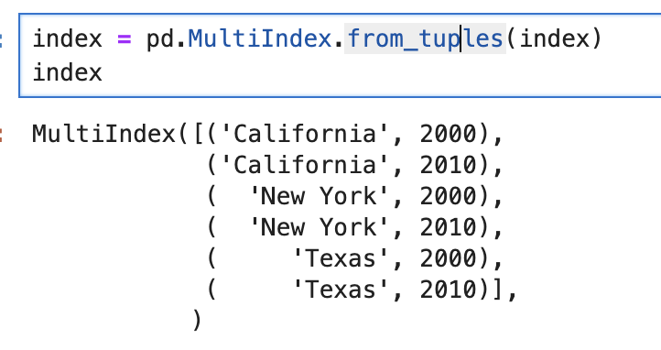
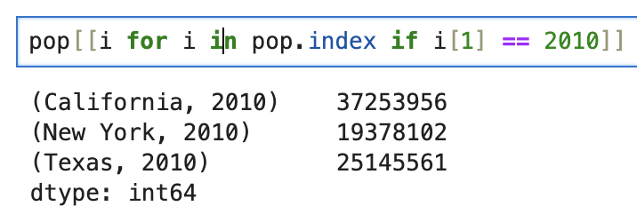
Multilevel indexing

Slide 10
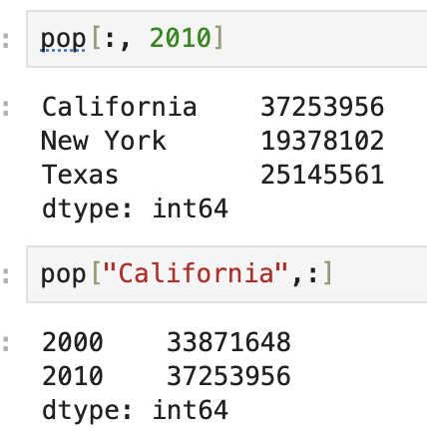
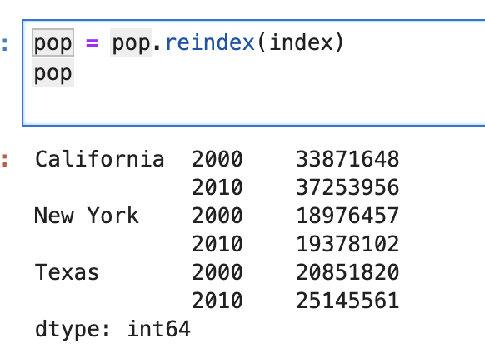
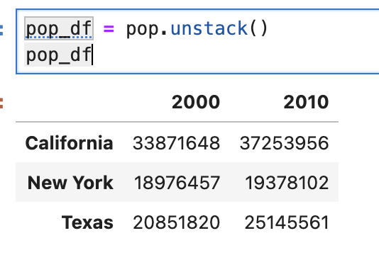
Multilevel indexing

Slide 11
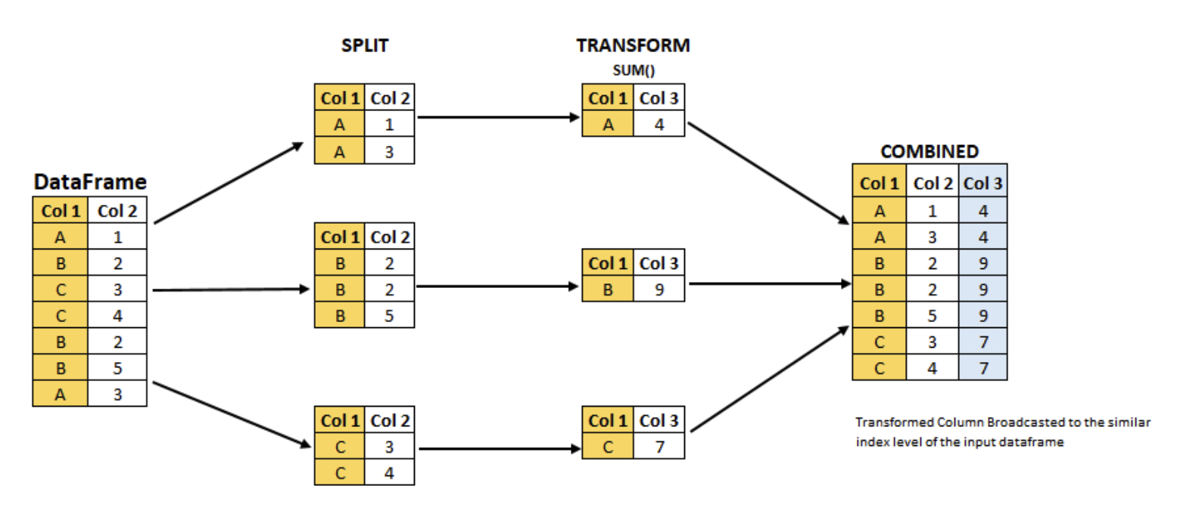
Groupby

Slide 12
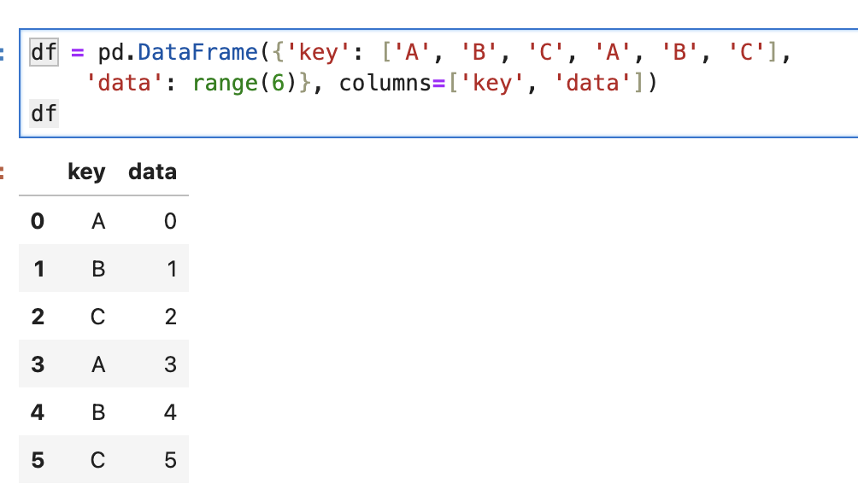
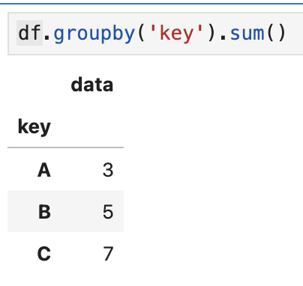
Groupby

Slide 13
xarray is similar to Pandas but for multi-dimensional data
A way to organize the data, which makes lots of computation (analysis) very easy and efficient

Slide 14
Xarray data structure
A way to organize the data, which makes lots of computation (analysis) very easy and efficient
Two types: DataArray and DataSet

Slide 15
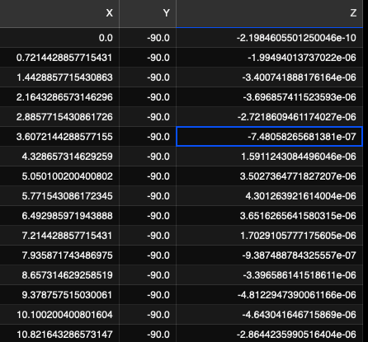
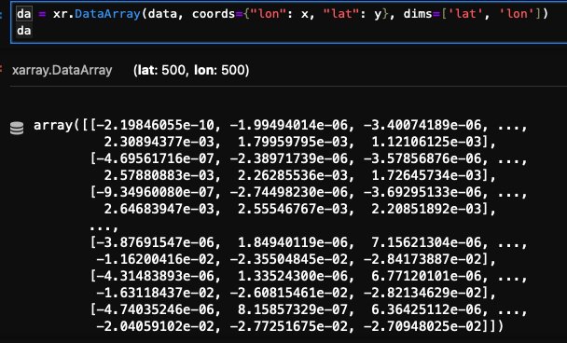
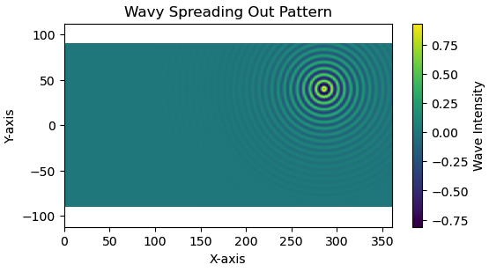
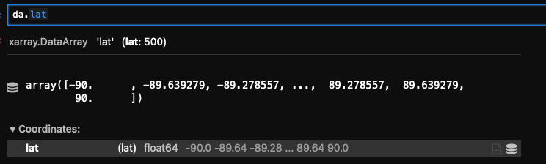

DataArray
What is needed to turn the table to a xarray DataArray?
Reshaped to (500, 500)

Slide 16
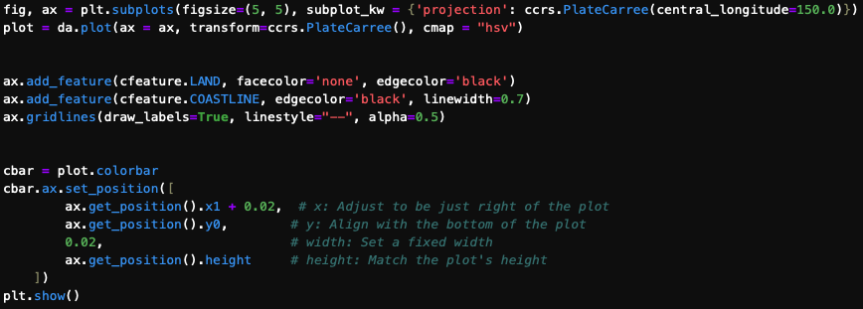
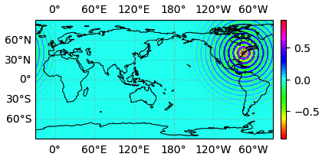
DataArray → DataArray with new dimension? DataArray → DataSet?

Slide 17
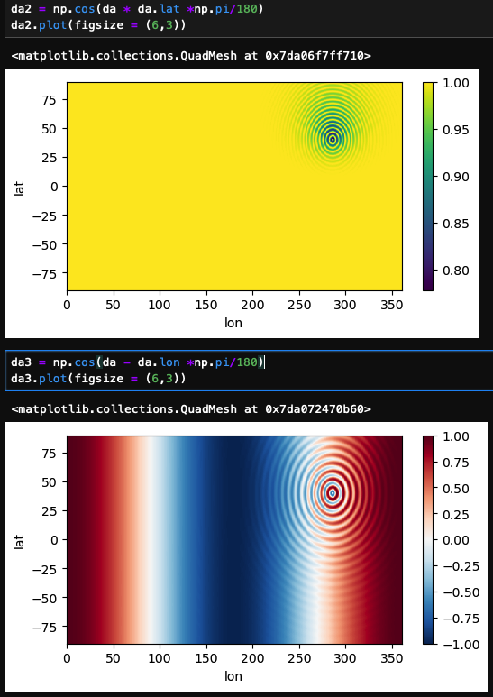
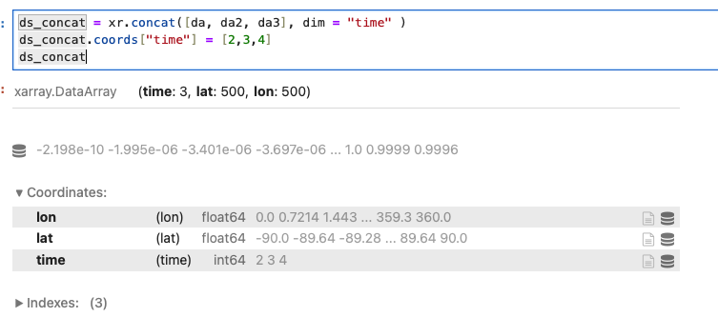
Let’s create two more DataArrays
DataArray → DataArray with new dimension?

Slide 18
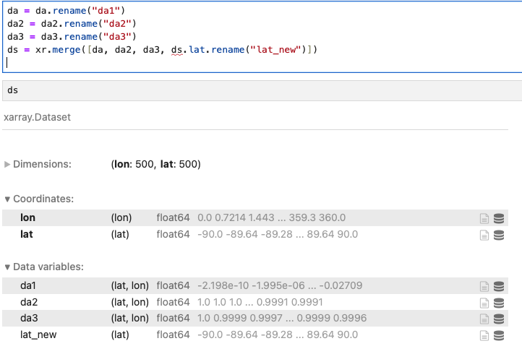
Put several DataArray to a DataSet
Previous (add new dimension)

Slide 19
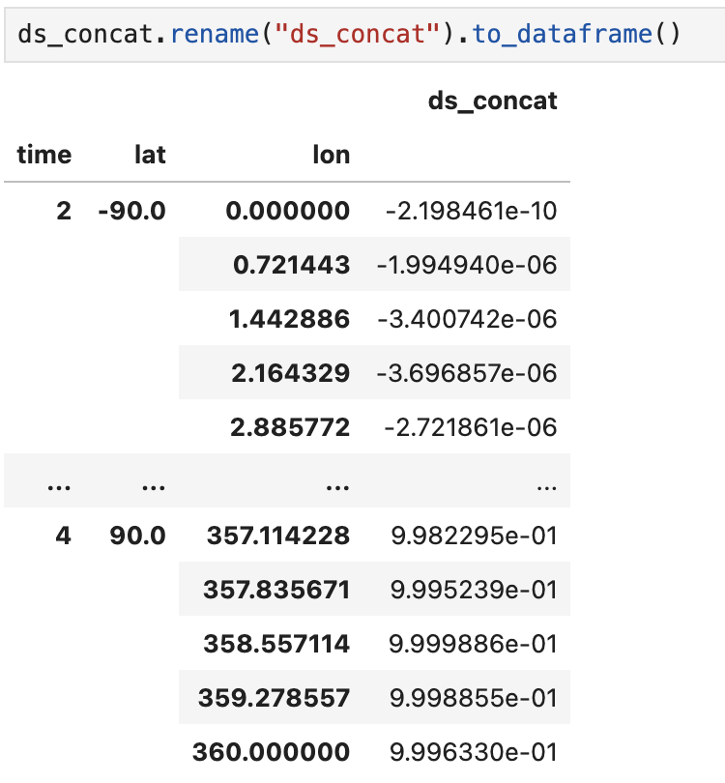

Slide 20
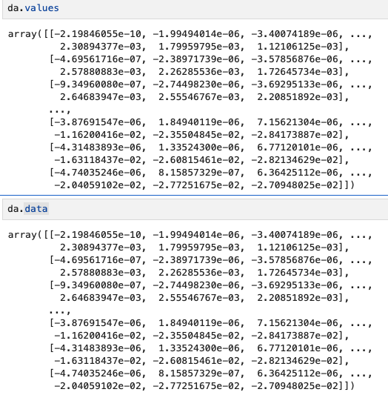
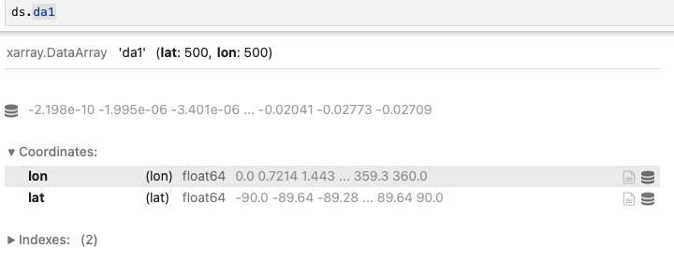
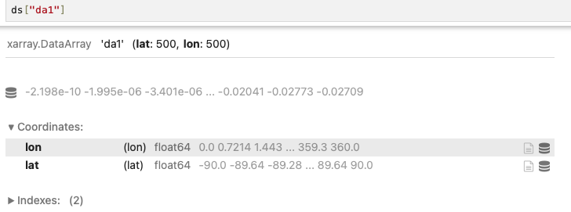
Access the “pure” data from DataArray and DataSet

Slide 21
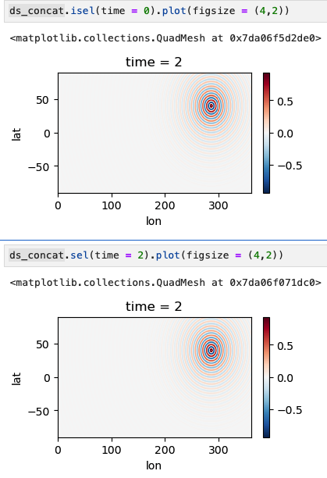
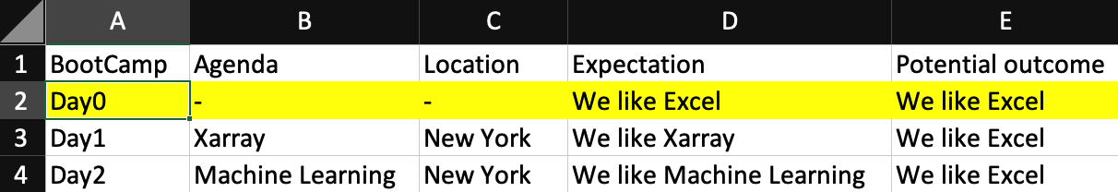
Data selection
sel: select the BootCammp column with its value = Day0
isel: select the BootCammp column with its row number = 0
Analogy not so accurate as we work with multi-dimensions

Slide 22
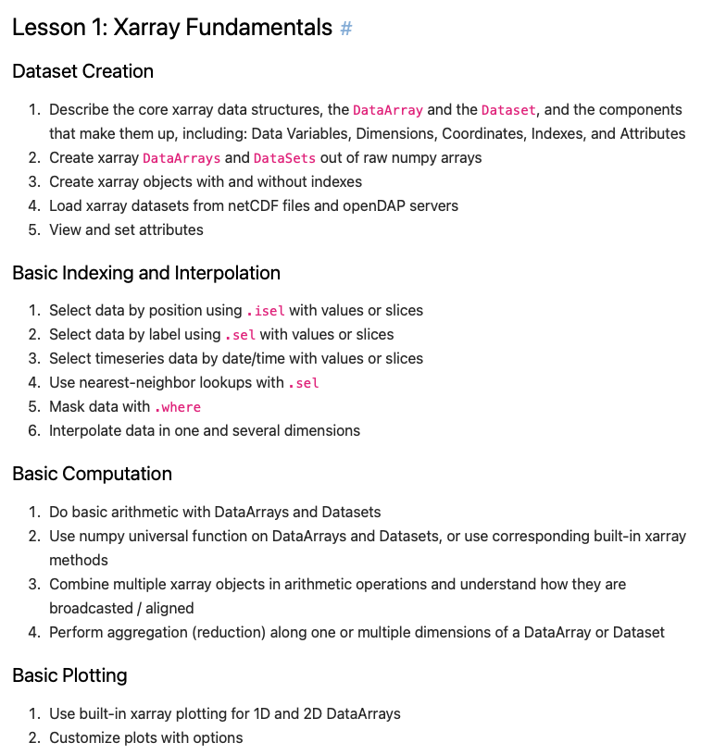
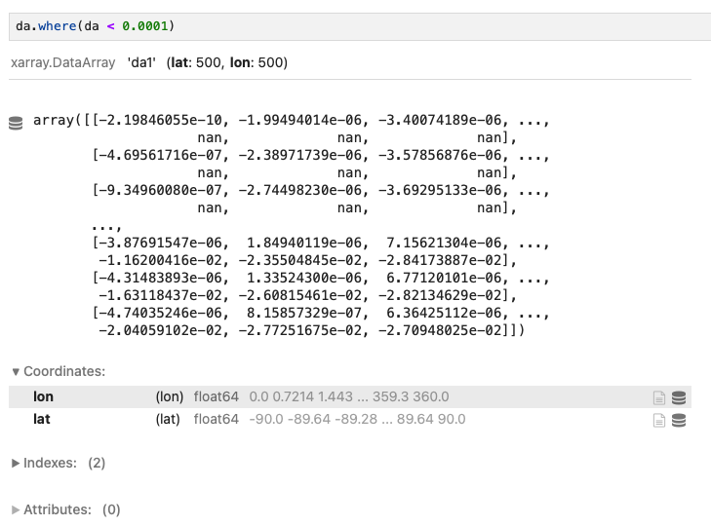
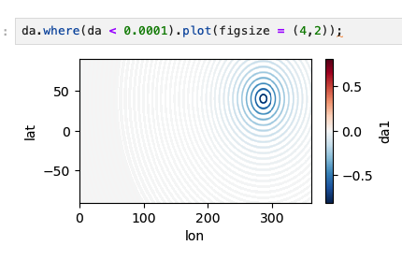

Slide 23
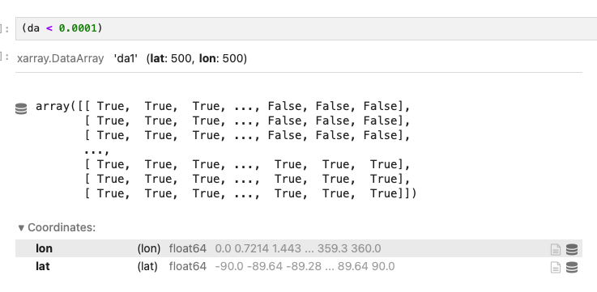
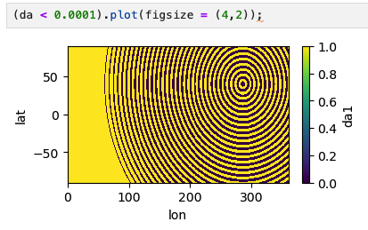
Mask!

Slide 24
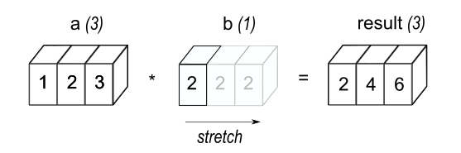
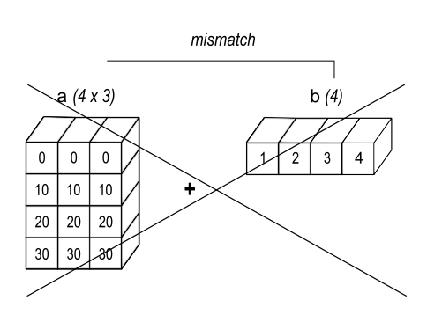
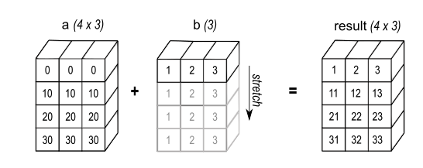
Broadcasting
a = [1,2,3]
b = [2]
a+b = [2,4,6]
https://numpy.org/doc/stable/user/basics.broadcasting.html

Slide 25
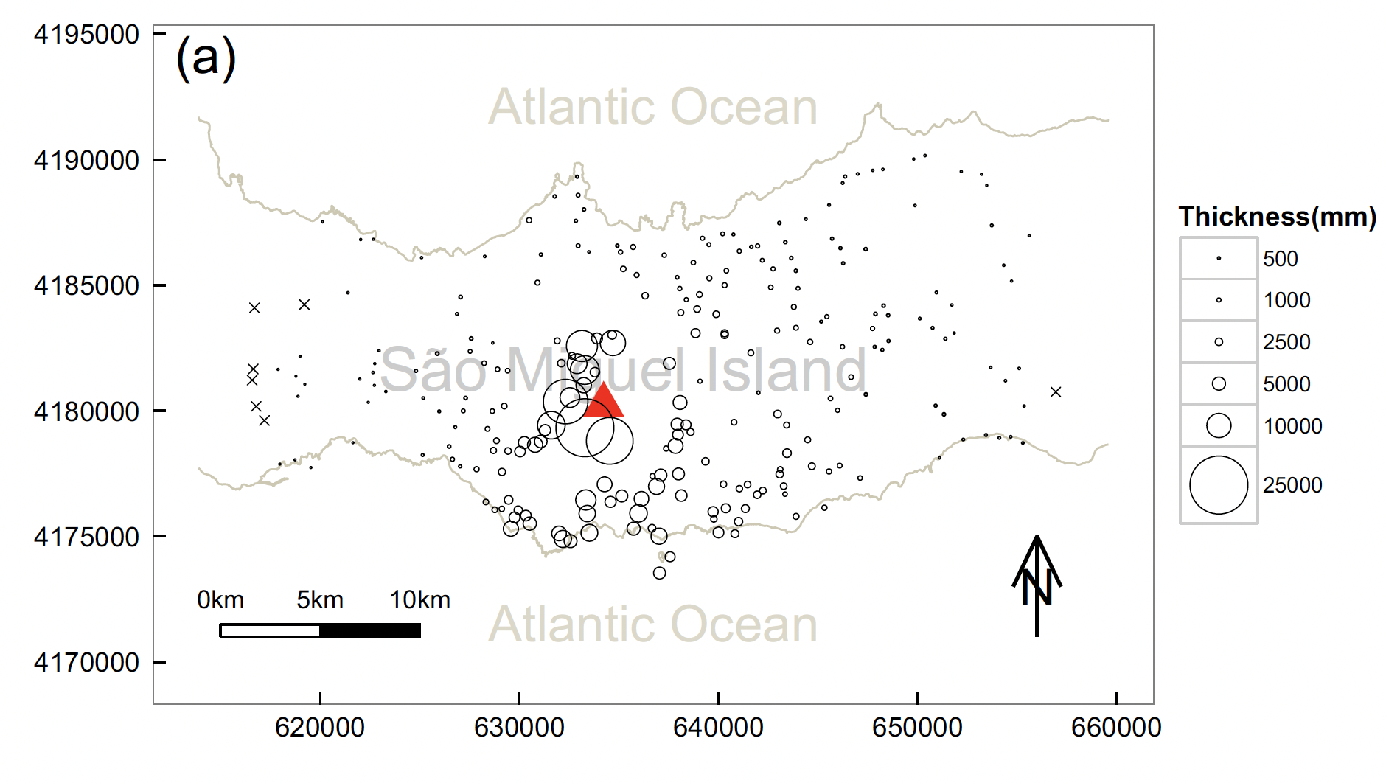
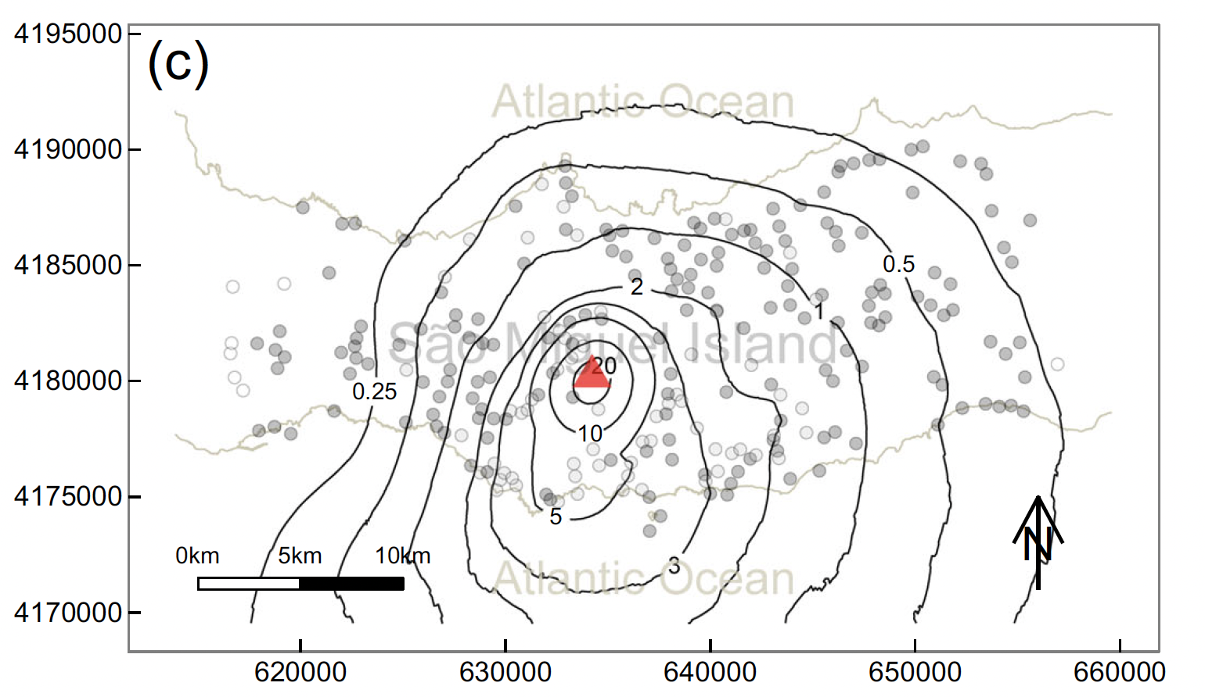
Interpolation and Extrapolation
Spatial or
Temporal (knowing the GDP of 1980 and 2020, predicting that of 1990 or 2030)

Slide 26
Groupby
Groupby in Pandas
Split, apply, and combine

Slide 27
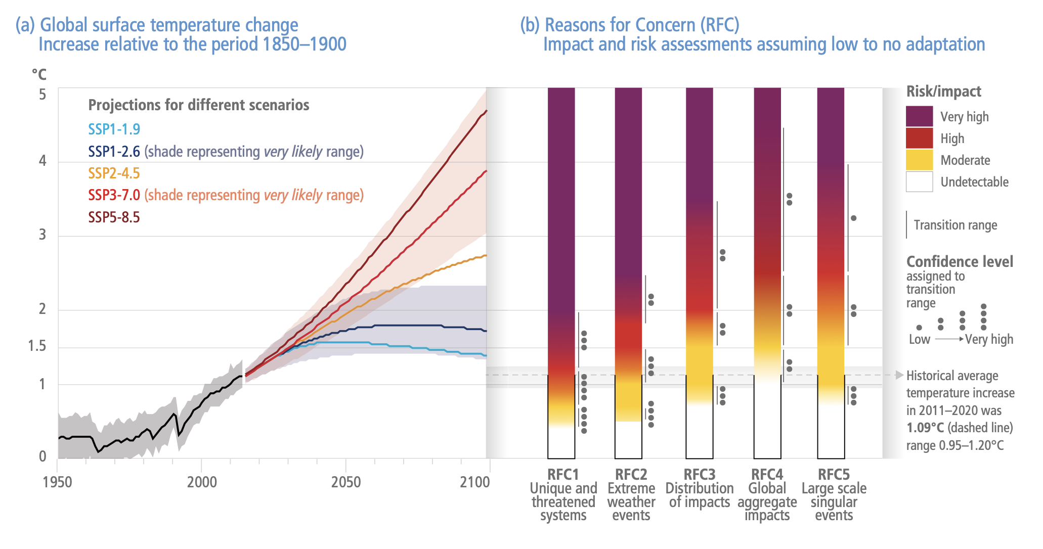
IPCC (The Intergovernmental Panel on Climate Change ) Report
A United Nations body for assessing the science related to climate change.
Publish every 5-7 year
SSPs: Shared Socioeconomic Pathways e.g., SSP2-4.5: This is a “middle of the road” scenario.: CO2 emissions hover around current levels before starting to fall mid-century, but do not reach net-zero by 2100.
How the future is projected?
p.18, Climate Change 2022 Impacts, Adaptation and Vulnerability Summary for Policymakers

Slide 28
IPCC (The Intergovernmental Panel on Climate Change ) Report
A United Nations body for assessing the science related to climate change.
Publish every 5-7 year
SSPs: Shared Socioeconomic Pathways e.g., SSP2-4.5: This is a “middle of the road” scenario.: CO2 emissions hover around current levels before starting to fall mid-century, but do not reach net-zero by 2100.
p.18, Climate Change 2022 Impacts, Adaptation and Vulnerability Summary for Policymakers

Slide 29
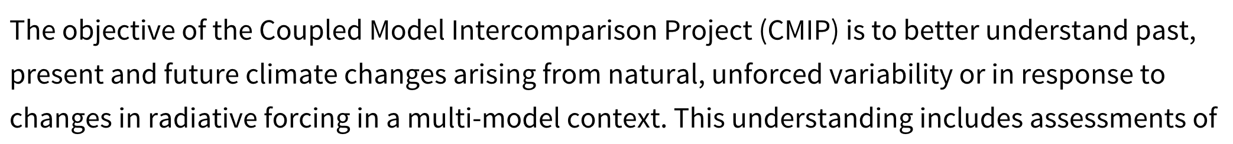
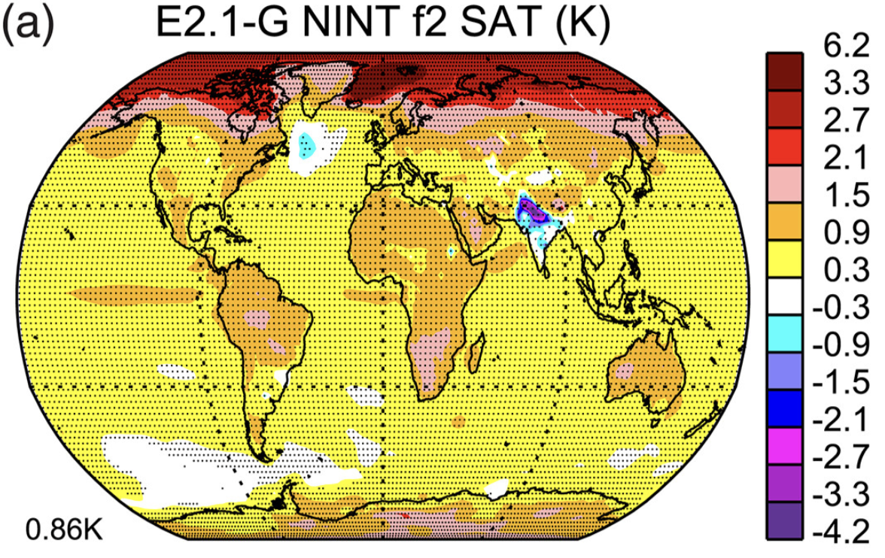
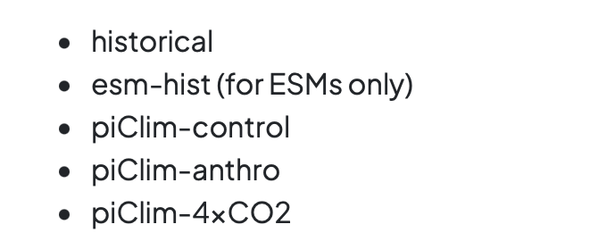
World Climate Research Programme Coupled Model Intercomparison Project (CMIP)
Different modeling centers run different scenarios (ongoing: CMIP7):
CO2 concentrations set to 4 times preindustrial
Fig 12a of Miller et al (2020) Change in ensemble and annual-average surface air temperature (K) between 1880–1899 and 2005–2014 from NASA GISS ModelE2.1-G NINT f2

Slide 30
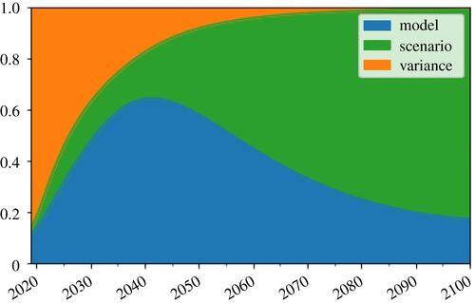

Why do we need results from these many modeling centers?
The models have a lot in common, and also different from each other.
Uncertainty in:
Model
Scenario
Variance (initial conditions)
Key difference between weather and climate: timespan
Fig 1 of Watson-Parris (2021). The fractional uncertainty in CMIP6 projections of surface air temperature due to internal variability, model uncertainty and scenario uncertainty as a function of time into the future
Why we need that many models?

Slide 31



A brief look of climate models
Community Earth System Model 2 (CESM2)
1.6 million lines of code
NASA GISS ModelE3
https://celebrating200years.noaa.gov/breakthroughs/climate_model/welcome.html
Fig. 1 of Danabasoglu et al (2020)

